Slide 1

A Final Year Internship Presentation on Web Development
Presented By:
Pankaj Bhattarai
TU Exam Roll No: 7985/072

Slide 2
Overview:
Introduction to project
Objectives
Roles and Responsibilities
System Analysis
System Design
Implementation
Conclusion

Slide 3
Introduction to Project:
ERP for vacker360 is a business process management software that includes different types of applications.
Event Management System is a module that can be used to manage the events occurring with in the organizations.
Another part of ERP is a Merge Tool that is used to merge more than one file together.
XML-RPC scripts is used to fetch, create, update and delete data from running Odoo database.
So, ERP for vacker360 is made up of these kinds of smaller modules which have their own functionalities.

Slide 4
Objectives:
Few major objectives of Event Management System are;
To plan the events more precisely.
To manage the events effectively and efficiently.
To keep track of all the outcomes of an event.
To utilize the available resources more efficiently.
Major objectives of Merge Tool are;
To merge more than one reports in one file.
To store the merged file so that it can be used for future use.

Slide 5
Objectives:
Major objectives of XML-RPC scripts are;
To manipulate the data existing on running databases.
To extract and store the data in different format.
To use the extracted data as a service in another application.

Slide 6
Roles and Responsibilities:
Task Assigned:
Period | Task
Week 1 | Background Knowledge and Development Environment Set Up
Week 2 | Create a new Blog application in Django
Week 3 | Background Knowledge of Odoo and Git
Week 4 | Create a new Module Library Management in Odoo
Week 5 | Extend the Library Management module with new features
Week 6 | Create new module Event Management System Depending on Calendar module
Week 7 | Extend Event Management System with additional features
Week 8 | Create new module Merge Tool
Week 9 | Create new module Merge Tool
Week 10 | Create XML-RPC scripts to manipulate data existing on running Odoo database
Week 11 | Create new Module Sale Delivery Date to calculate the delivery periods
Week 12 | Create new tool to merge CSV files

Slide 7
System Analysis:
System Requirements
Functional Requirements
Event Management System:
User must be authenticated to use the system.
Users must provide the necessary information to manage the events.

Slide 8
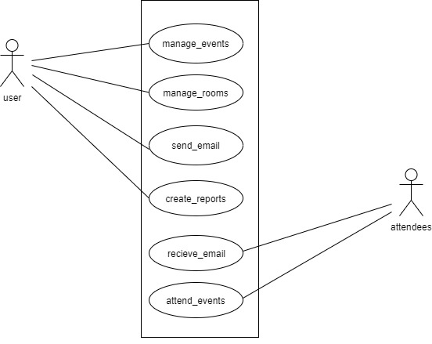
System Analysis:
Use case diagram of Event Management System

Slide 9
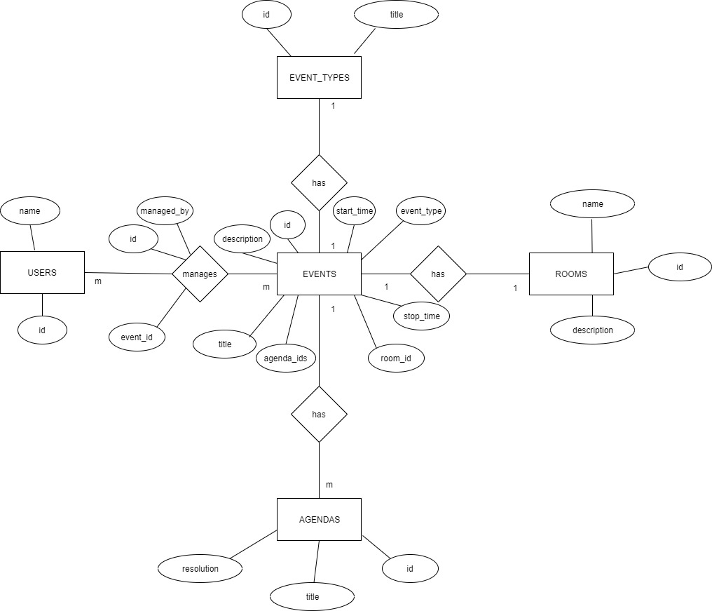
System Analysis:
Data Modeling
ER Diagram of Event Management System

Slide 10
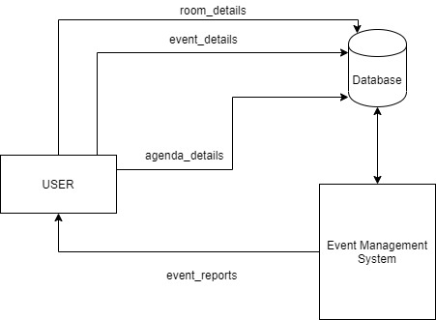
System Design:
Block Diagram of Event Management System

Slide 11
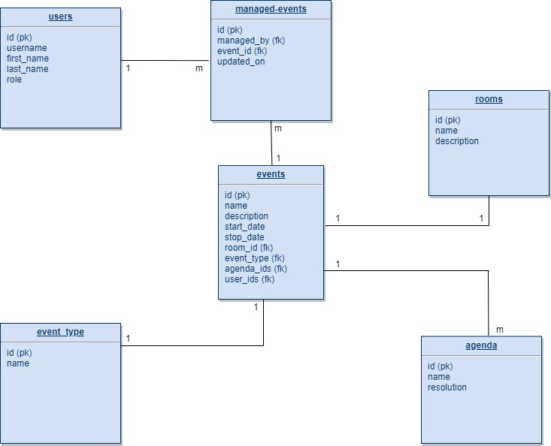
System Design:
Database Schema Design of Event Management System

Slide 12
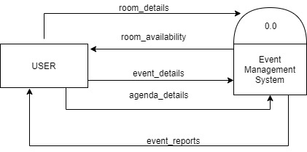
System Design:
Level 0 DFD of Event Management System

Slide 13
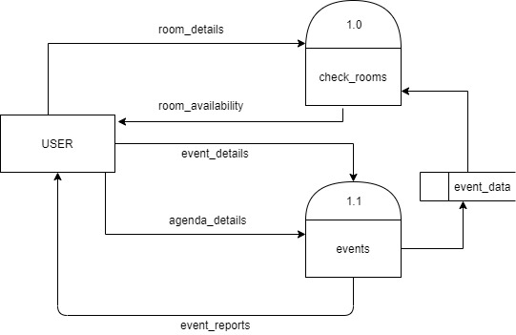
System Design:
Level 1 DFD of Event Management System

Slide 14
Implementation:
Tools
Odoo Framework(Python)
XML
PostgreSQL
Git

Slide 15
Conclusion:
Developed various application in Odoo such as Event Management System, Merge Tool, Library Management, XML-Scripts and many more.
Learned about new technologies and IT environment.
Improved communication and collaboration skills.

Slide 16
Any Questions???

